Slide 1
Truth or Myth: ‘Women and Children First’ During the Evacuation of the Titanic
Notes:
Intro:
Introduce the topic and the question that you are investigating.

Slide 2
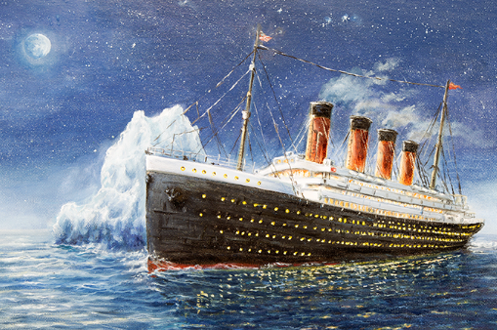
What have you heard about the Titanic?
“History is what happened, not what we wish had happened.”
~ Thomas Sowell
“If you state something and keep repeating it, people will eventually come to believe it.”
~ Joseph Goebbels
Notes:
What I’ve found is that there are a lot of misconceptions about the facts associated with various historical events.
Joseph Goebbels: "If you state something enough and keep repeating it, people will eventually come to believe it.”
History is what happened, not what we wish had happened.” — Thomas Sowell
What are some of the ”facts” that you all have heard about the Titanic?
3rd class passengers were locked in the belly of the Titanic and left to die – need context
Titanic was unsinkable – needs context
The champagne bottle used to christen the ship didn’t break, signally a cursed ship - myth
The shortage of lifeboats resulted in the high number of casualties –myth
The band continued to play as the Titanic sank – fact
Women and Children First
Truth or Myth: Were women and children given priority during the evacuation of the Titan.

Slide 3
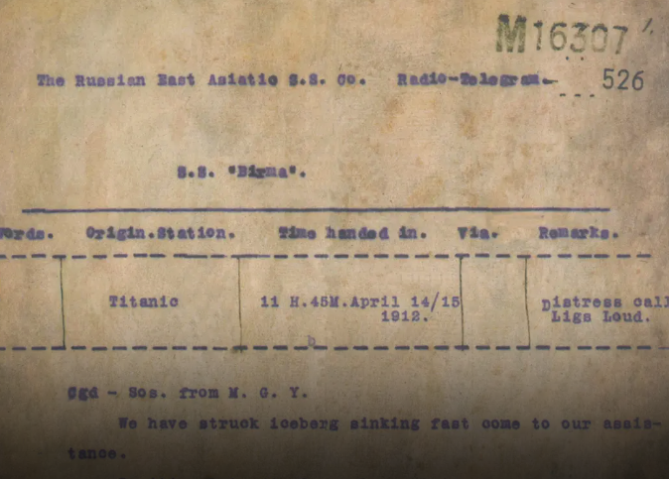
RMS Titanic Timeline – April 14, 1912
11:40pm – Iceberg is spotted
11:50pm – Titanic collides with the iceberg
12:00am – Distress telegram sent
12:05am – Capt. Smith orders the lifeboats to be uncovered
12:45am – The first of eight distress rockets are sent up and Capt. Smith orders a “Birkenhead Drill”
1:05am – First lifeboat landed
2:05am – Final lifeboat landed
2:17am – Final radio communication with Titan
Notes:
On April 14, 1912, the RMS Titanic collided with an iceberg in the North Atlantic and sank on its maiden voyage.
On board the Titanic:
1309 passengers: 1st (324), 2nd (284), and 3rd (709)
Many of the 2nd and 3rd passengers were European citizens immigrating to America to start a new life.
Just over 900 crew members
Review timeline
Text of the distress telegram.
“We have struck an iceberg we are sinking fast come to our assistance.”
What is a “Birkenhead Drill”?

Slide 4
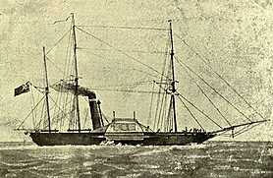
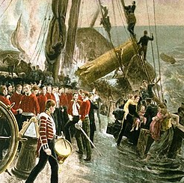
HMS Birkenhead - 1852
Notes:
The phrase “Birkenhead Drill” originated from another maritime disaster in 1852.
The HMS Birkenhead was transporting British soldiers and supplies to the Eighth Cape Frontier Wars. Also abroad were 27 women and children.
On February 26, the Birkenhead struck some rocks, tearing open the hull of the ship.
The commanding officer of the Birkenhead ordered his crew to prioritize the evacuation of the “youngest passengers and the women who cared for them”.
After loading and lowering the lifeboats, the remaining men went down with the ship and either drown or fell victim to shark attacks.
However, every woman and child on board the Birkenhead survived
King Frederick William of Prussia: the story read aloud to every regiment in his army as an example of supreme discipline, courage and self-sacrifice.
The disaster also gave rise to the ‘Birkenhead Drill’ meaning ‘women and children first’ as a standard procedure during any sinking.

Slide 5
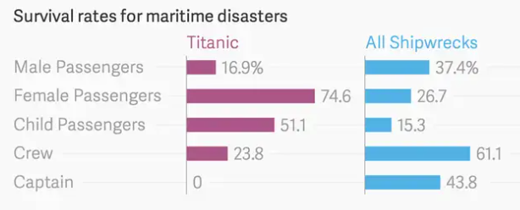
Birkenhead Drill – Has it been practiced?
Notes:
In 1912, no maritime governing body oversaw the safety of transatlantic passenger vessels
However, the Birkenhead Drill was part of the code of conduct that all ship officers pledged to follow
In fact, evacuation of the HMS Birkenhead, is more of a rare exception instead of the standard practice.
In 2012, researchers with Stockholm’s Research Institute of Industrial Economics examined 18 famous shipwrecks (1851 and 2011),
and found that women and children tend to survive at a lower rate than their male counterparts.
In fact, it would appear that it is “crew and captain first”.
Further noting the idea that women and children are given preferential treatment in maritime disasters is a myth.
However, two noted exceptions to this conclusion were the HMS Birkenhead disaster in 1852 and the RMS Titanic disaster in 1912.
Perhaps the principle of “women and children first” was observed aboard the Titanic and that’s why it has been tied to the Titanic disaster.

Slide 6
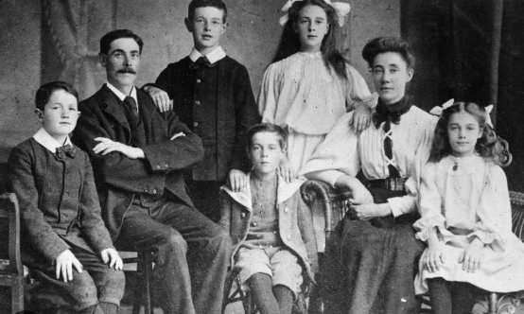
A note about the dataset used in our analysis
Notes:
Didn’t use Kaggle version of the dataset
The dataset utilized in this analysis was curated by Dave Fowler (2022).
Fowler used a combination of historical documents, census data, and genealogical records to reconstruct the demographics of each of the Titanic’s passengers.
Fowler’s dataset is the most comprehensive and complete view of the Titanic passengers.
To accommodate our analysis, the original dataset needed to be extended to include a feature indicating whether the passenger was an adult or a child.
Fowler noted that the Titanic offered a child passage rate for guests 12 years of age and under.
However, the societal norm in the 1910s was to consider the age of 16 to distinguish between adults and youth.
For this analysis, we will use the societal norms of the time and conclude that passengers 16 and older as adults.
The principle explicitly calls out “women and children.” So, let’s collapse everything into three groups: children, women (adult females), and adult males.
Good news , bad news…
We now see a distinct difference in the survival rate of adult males versus children or adult females.
However, a significant gap exists in the survival rate of adult females and children.

Slide 7

Hypothesis Testing
Passengers Overall
Titanic Survivors
H0: There is no difference between the average age of female and male Titanic passengers. (µf -µm = 0).
H1: There is a difference between the average age of female and male Titanic Passengers. (µf -µm != 0)
H0: There is no difference between the average age of female and male Titanic survivors. (µf -µm = 0).
H1: There is a difference between the average age of female and male Titanic survivors. (µf -µm != 0)
Notes:
Maybe hypothesis testing can shed some light on this
If the principle “women and children first” were observed during the Titanic’s evacuation, we’d expect to see a difference in the mean survival age between female and male passengers.
Here’s our reasoning:
Adult and child females should have been prioritized when evacuating the Titanic.
Compare that to males, where only children were to be given priority.
Thus, we expect the mean age of survivors in females to be higher than in males.
In other words, if we test for the means to be equal, we should see that our hypothesis is not statistically supported by the data if “women and children” were prioritized during the evacuation.
But first we should probably stop and verify that the mean age between the two genders was similar to begin with.
Both of these tests use an alpha of 5% to evaluate the null hypotheses.
Concluding that there is no difference between the average age of female and male Titanic survivors.
Not exactly what we were expecting to find if “women and children” were given priority during the evacuation of the Titanic.

Slide 8
Machine Learning and the Random Number Trick
Feature | Importance
pclass | .28
sex | .22
p_type | .19
rand_num
Notes:
What is the Random Number Trick?
The Random Number leverages the features of importance results from a random forest model.
Add a random num feature to the dataset - the goal is to mimic a genuinely random process in this newly created feature.
Construct a random forest model to represent the underlying data (with the new rand_num feature)
For this analysis, the features pclass, sex and p_type and survived as the target were used in constructing the model.
An 80/20 split was used in constructing this model and tuned to an 88.6% accuracy.
Then, the features of importance were retrieved.
Overall, any feature above the rand_num had a greater influence in creating our model than a completely random event.
But more importantly where did our rand_num fail in the listing.
Not the best news. If the principle of “women and children first” were present during the Titanic’s passenger evacuation, we would expect to see sex and p_type above the rand_num.

Slide 9



Women and Children First?
Descriptive Statistics
Hypothesis Testing
ML: Random Number Trick
Notes:
So, back to your original question: Truth or Myth: Were women and children given priority during the evacuation of the Titan.
Remember, that study by the Stockholm Research Institute of Industrial Economics,
They noted that the principle of “women and children” might be something to strive for,
However, the reality is more like “crew and captain first”.
From the various survivor accounts:
Many noted that the crew was disorganized and panicked while trying to evacuate the passengers
Additional accounts reported that little to no action happened in the first hour after striking the iceberg.
The captain ordered the lifeboats to be uncovered but failed to give the order to evacuate
The first lifeboat was launched with 4 people in it.
There were reports of first-class male passengers being loaded into lifeboats ahead of waiting mothers and their children.
At times prominent passengers seized control of situations to get people loaded into awaiting lifeboats, because of the lack of direction from the crew.
The most notable of these passengers was Margaret “Molly” Brown
The evacuation from the Titanic was chaotic and disorganized at best.

Slide 10
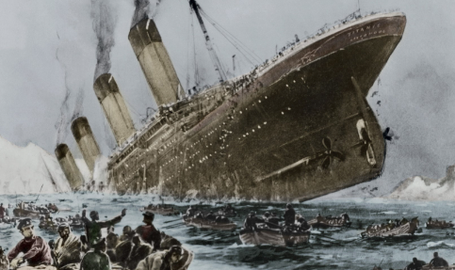
Future Works
Notes:
Possible future works:
Re-examining using 16 as the adult/child delimiter. Some researchers have suggested that societal norm where not applied equally across all levels of society.
By blanketly using 16 years of age as the sole determining metric
between an adult and child, we cannot know if that same metric would have been applied
during the evacuation process. There are no reports of crew members asking individuals their age as the boats were being loaded.
So it is possible that our metric is different from one that could have been used on the Titanic.
- Understanding how passenger class fit into the evacuation process

Slide 11
References
Crossing the Atlantic. (n.d.). National Geographic. Retrieved from https://www.nationalgeographic.org/activity/crossing-the-atlantic-then-and-now/.
Daugherty, G. (2023). Titanic: the surprising calm before the chaotic sinking. Retrieved from https://www.history.com/news/titanic-final-hours-passengers-lifeboats/.
Debczak, M. (2022). Women and Children First: How a Rarely-Used Maritime Practice Caused Confusion On Board the 'Titanic'. Retrieved from https://www.mentalfloss.com/posts/women-and-children-first-origins-titanic.
Fowler, D. (2022). Titanic Facts. Retrieved from https://titanicfacts.net/.
Fowler, D. (2022). Titanic Facts Passenger List [Dataset]. Retrieved from https://titanicfacts.net/passenger/.
Mukhiya, S. K., & Ahmed, U. (2020). Hands-on exploratory data analysis with Python. Packt Publishing.
Notes:
Reference slide

Slide 12
References
Olden, L. (2018). Women and children first, not an official rule. Retrieved from https://www.themarysue.com/women-and-children-first-not-an-official-rule/.
Pasick, A. (2015). “women and children first” is a maritime myth. Retrieved from https://qz.com/321827/women-and-children-first-is-a-maritime-disaster-myth-its-really-every-man-for-himself/.
Women and Children First. (n.d.). National Army Museum. Retrieved from https://www.nam.ac.uk/explore/birkenhead-sinking.
Notes:
Reference slide

